Slide 1
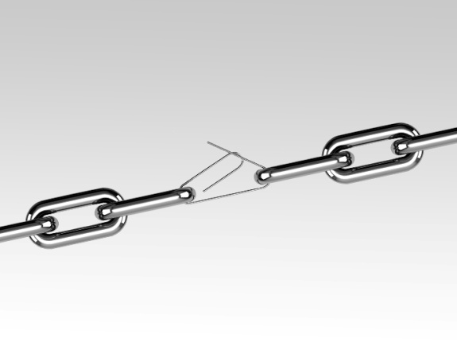
SWOT Analysis
Positive
Negative
S
W
S
Internal Factors
Weaknesses
Strengths
O
T
External Factors
Opportunities
Threats

