Slide 1
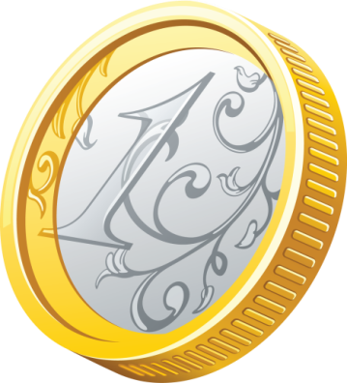
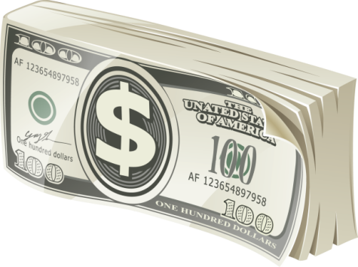
MONEY
5,03%
0,03%
7,16%
EXAMPLE TEXT
EXAMPLE TEXT
EXAMPLE TEXT

