Slide 1
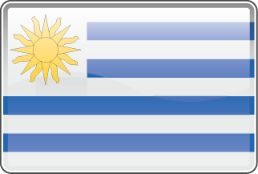
ё
North, Central and South AMERICAN COUNTRY FLAGS
Argentina
Antigua and Barbuda
Bahamas
Barbados
Belize
Bolivia
Brazil
Canada
Chile
Colombia
Costa Rica
Cuba
Dominica
Dominican Republic
Ecuador
El Salvador
Green Land
Guatemala
Guyana
Haiti
Honduras
Jamaica
Mexico
Nicaragua
Panama
Paraguay
Peru
Puerto Rico
Suriname
Trinidad Tobago
United States
Uruguay
Venezuela

