Slide 1
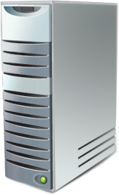
放射图示
RD Gateway
RD Gateway
RD Gateway
RD
RD Gateway
RD Gateway
RD Gateway

