Slide 1
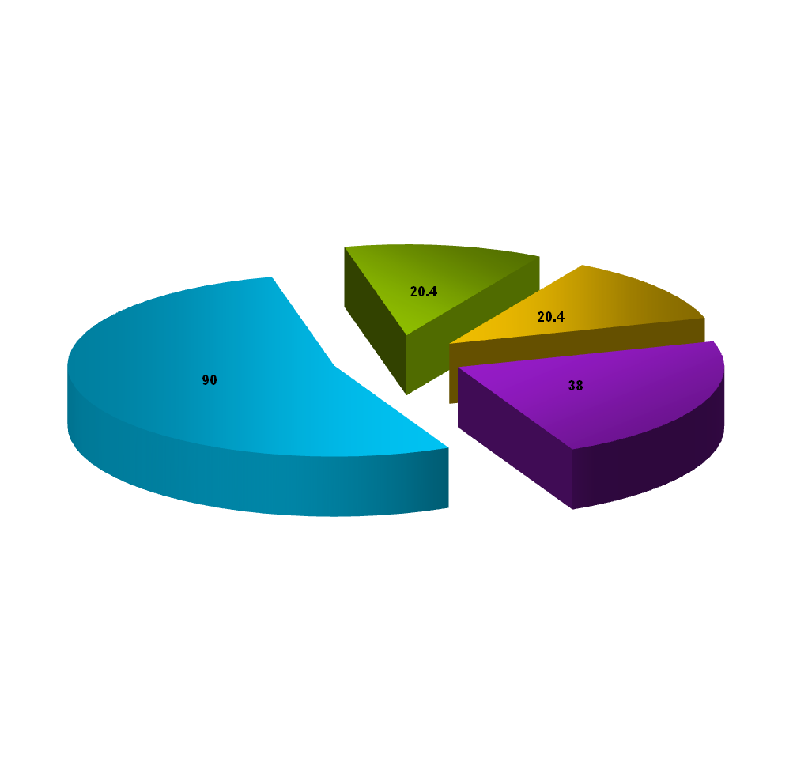
20.4%
90%
Description of the company’s products
20.4%
Description of the company’s products
Description of the company’s products
38%
Description of the company’s products
Notes:
更多PPT素材与教程，请登录PPTfans,PPT设计教程网：http://www.pptfans.cn

